Slide 1

Soil Testing and Smart Irrigation System
Team Rakibul Hasan Rezvee Joy Das Nusrat Chowdhury Ulope Das Majeda Akter

Slide 2
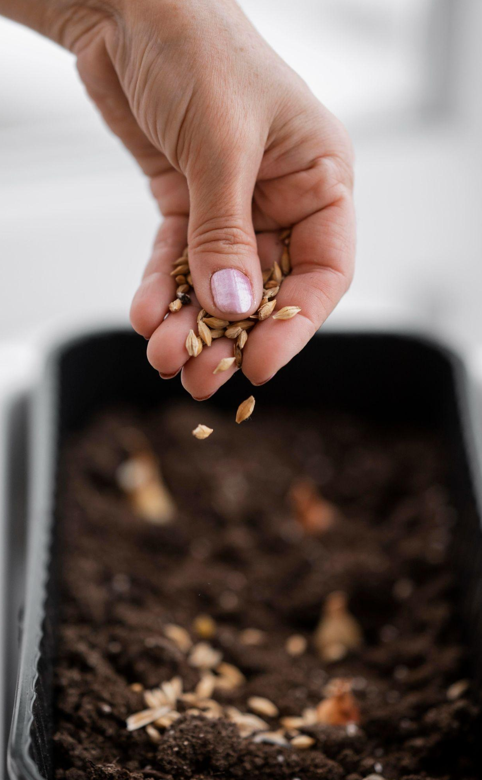
Problem Statement
01
02
03
04
Farming Guesswork
Underwatering
Farmers often rely on guesswork to decide watering and fertilizing schedules.
This guesswork causes crops to receive too much or too little water.
Nutrient Imbalance
Need for Automation
Incorrect fertilizer use leads to poor soil nutrient balance and low yield.
An automated system is needed to monitor soil and control irrigation accurately

Slide 3

Objective
Soil Monitoring
Real-Time Display
The system measures soil moisture, NPK nutrients, pH, and temperature.
Venus has extremely high temperatures
Automatic Irrigation
Resource Efficiency
Irrigation is controlled automatically based on soil moisture levels.
This helps farmers save water and increase crop productivity.

Slide 4
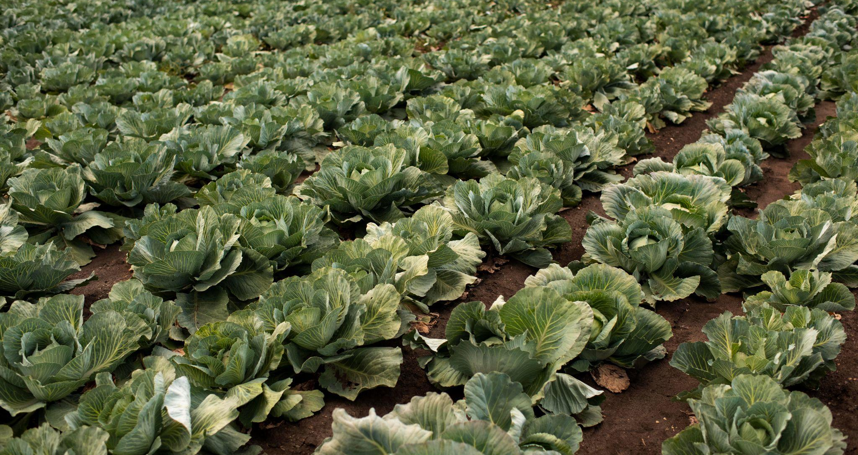
Components Used
•ESP32 Microcontroller
•Soil Moisture Sensor
•NPK Sensor
•pH Sensor
•Temperature Sensor
•OLED Display
•Water Pump
•Power Supply

Slide 5
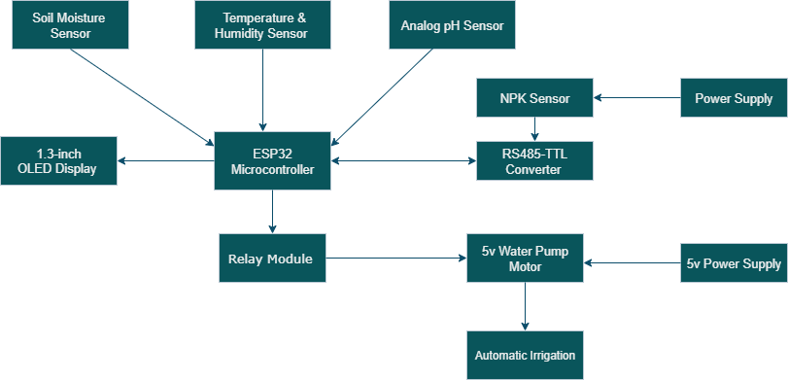
Block Diagram

Slide 6
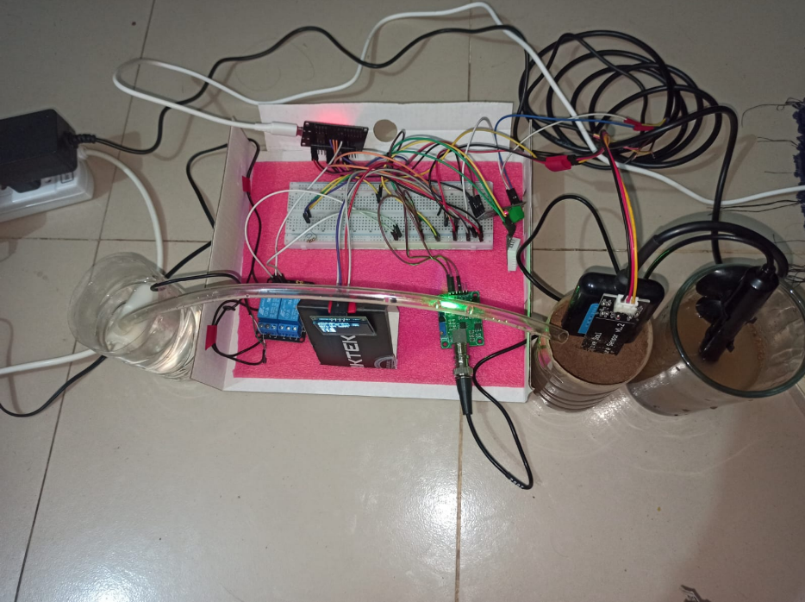
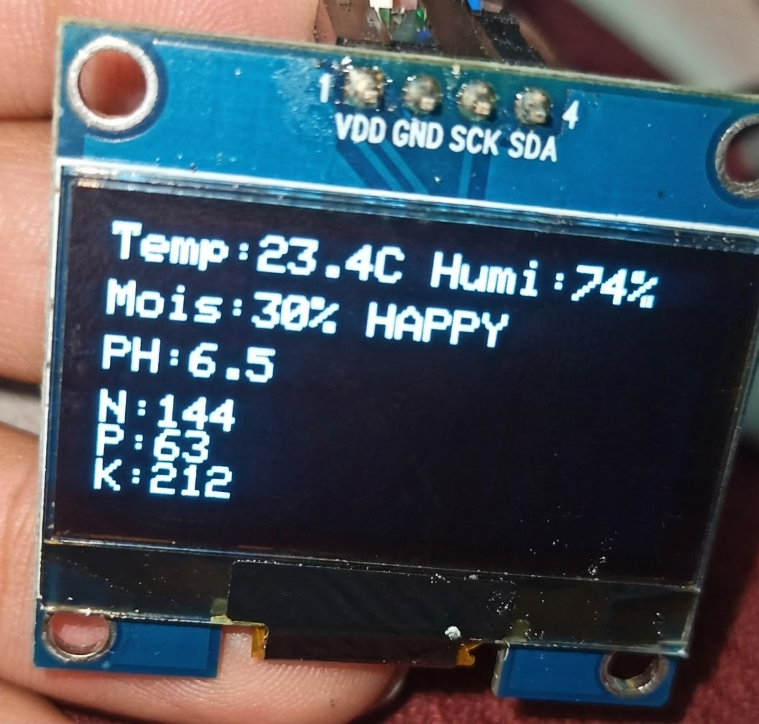
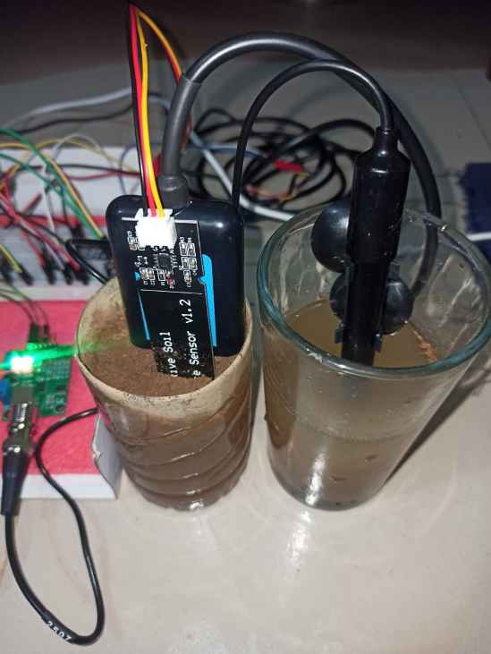
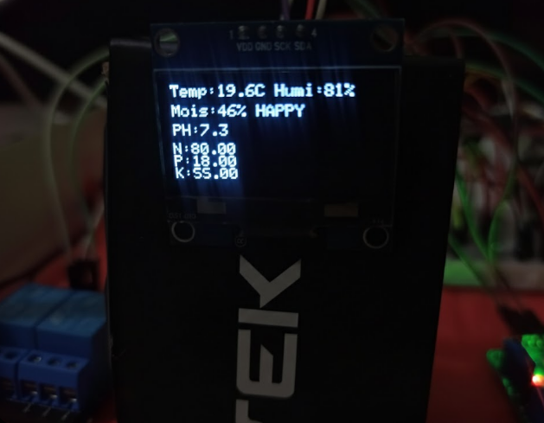
Implementation Results
System Accuracy: The ESP32 successfully processed real-time data for Nitrogen, Phosphorus, Potassium (NPK) , and pH levels.
Automation Success: The Relay Module triggered the 5v Water Pump ON when moisture was low and OFF when the optimal level was reached.
Data Visualization: Real-time soil metrics were clearly displayed on the 1.3-inch OLED Display , removing all farming guesswork.

Slide 7
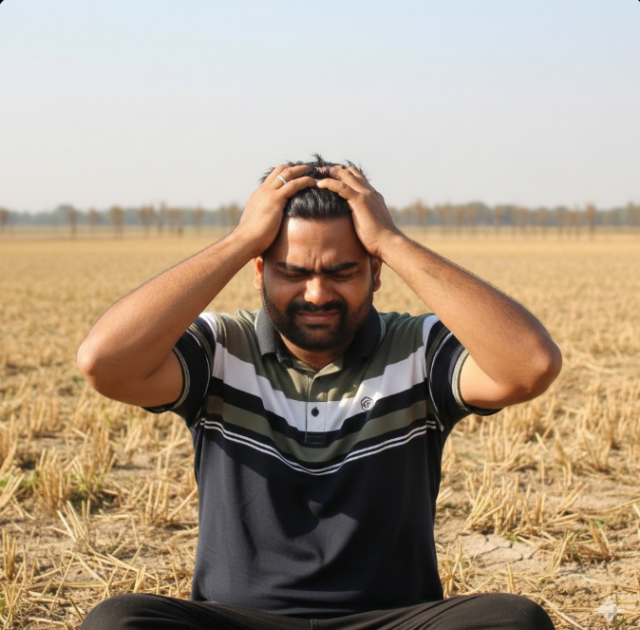
Challenges & Solutions
Sensor Calibration: Managed signal stability for the NPK sensor using an RS485-TTL Converter for accurate data processing by the ESP32.
Power Management: Used a dedicated 5v Power Supply for the Water Pump Motor to prevent system resets during irrigation
Hardware Integration: Successfully wired the Analog pH and Temperature sensors to provide a comprehensive soil monitoring interface.

Slide 8

Future Plan
Enable farmers to track soil and irrigation data through a mobile app
Send SMS or app notifications when soil conditions require attention.
Cloud & App Monitoring
Alert System
Solar Integration
Fertilizer Automation
Power the system using solar energy for continuous field operation.
Add automatic fertilizer control for balanced nutrient management.

Slide 9
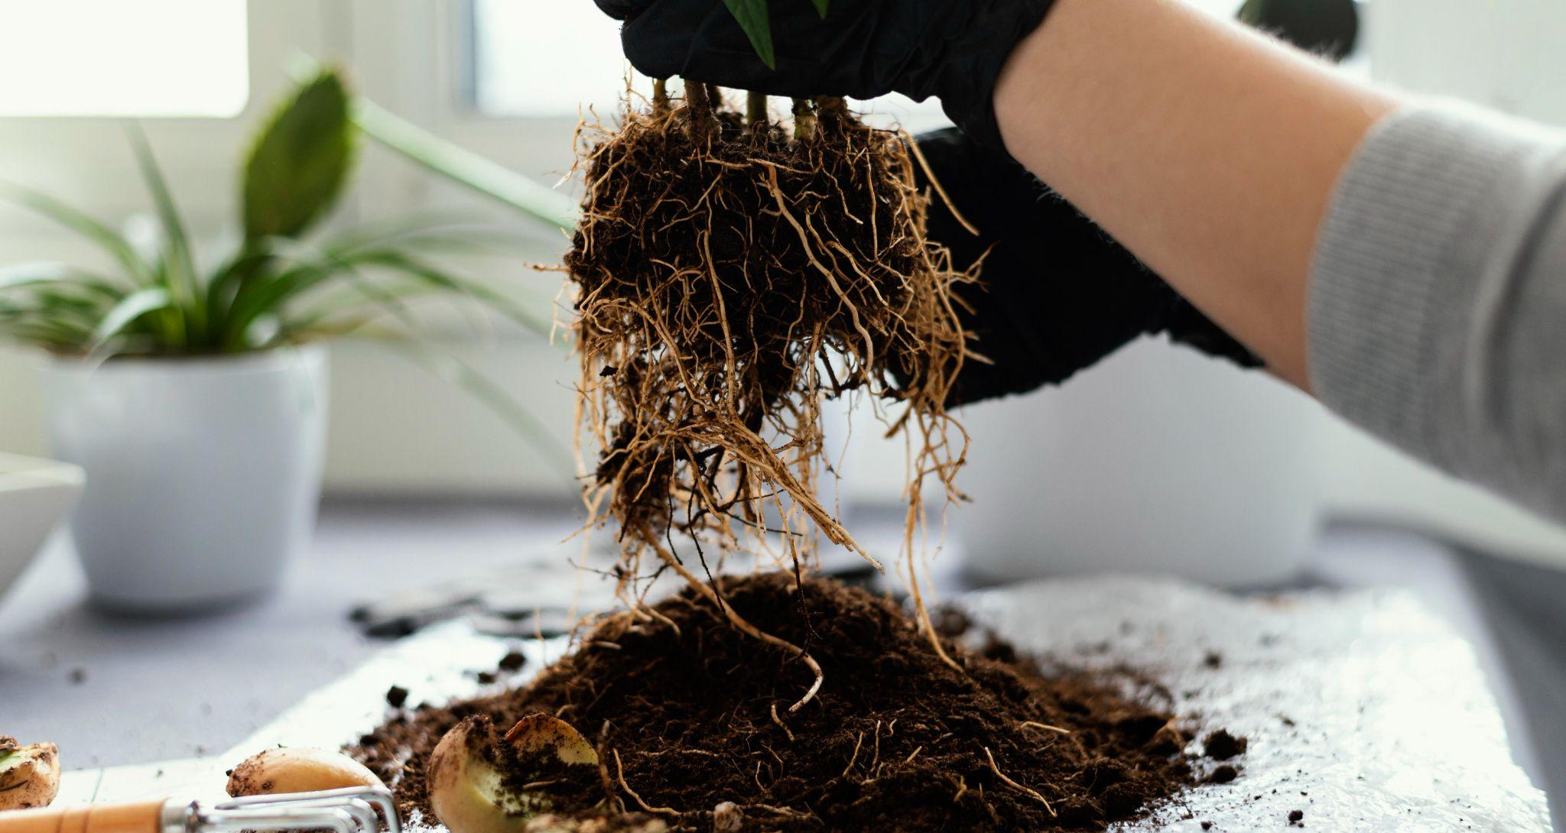
Thank you!

